Slide 1
ECE2810J Data Structures and Algorithms
AVL Trees
Learning Objectives:
Know the general balanced condition for a balanced search tree
Know the balance condition of an AVL tree and balance factor
Know the four types of rotation operations for an AVL tree and how to apply them during insertion

Slide 2
Outline
Balanced Search Trees
AVL Trees
AVL Tree Insertion
Supporting Data Members and Functions of AVL Tree

Slide 3
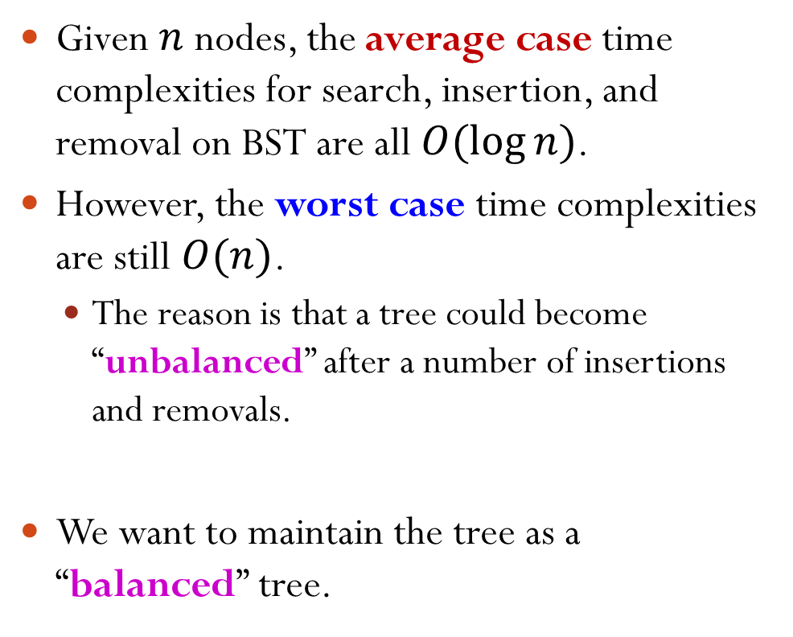
Motivation
Given $n$ nodes, the average case time complexities for search, insertion, and removal on BST are all $O(\log{n})$.
However, the worst case time complexities are still $O(n)$.
The reason is that a tree could become “unbalanced” after a number of insertions and removals.
We want to maintain the tree as a “balanced” tree.
4
3
6
7
9

Slide 4

Balanced Search Trees
What are the requirements to call a tree a balanced tree?
Would you require a tree to be perfect/complete to call it balanced?
No! They are too restrictive.

Slide 5
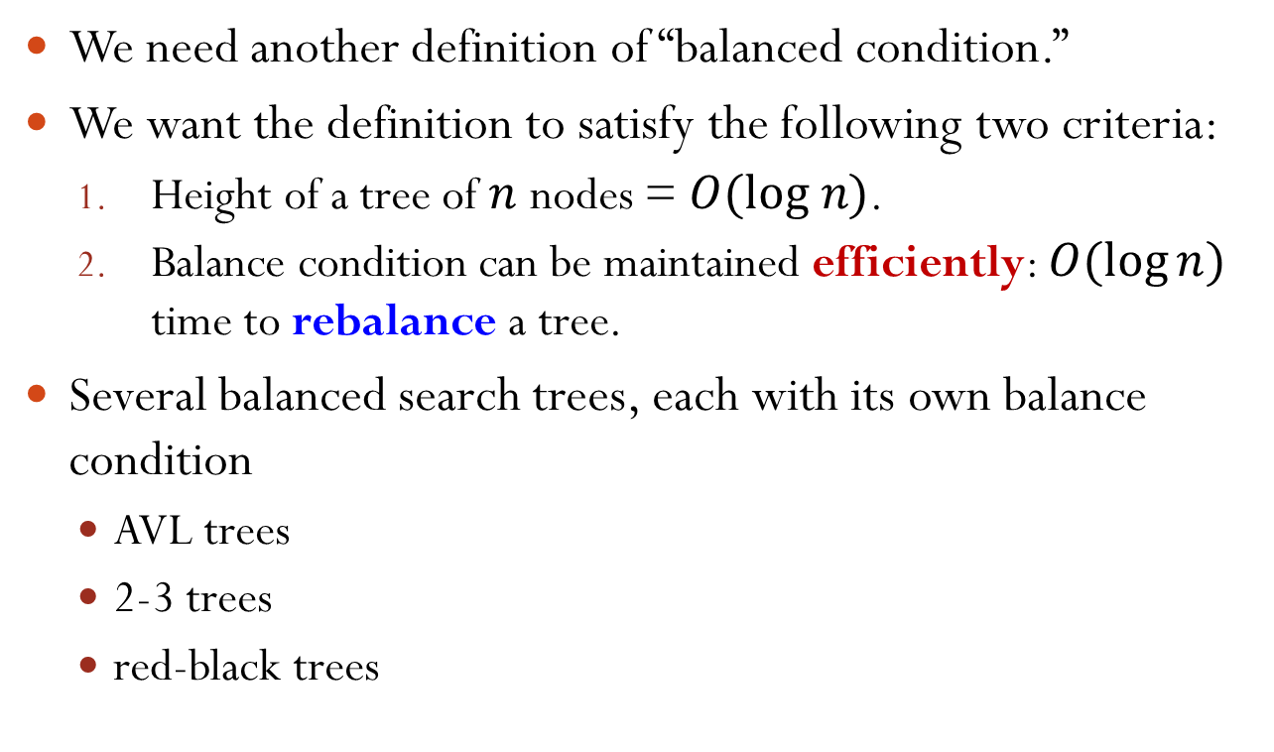
Balanced Search Trees
We need another definition of “balanced condition.”
We want the definition to satisfy the following two criteria:
Height of a tree of $n$ nodes = $O(log n)$.
Balance condition can be maintained efficiently: $O(\log{n})$ time to rebalance a tree.
Several balanced search trees, each with its own balance condition
AVL trees
2-3 trees
red-black trees

Slide 6
AVL Trees
Adelson-Velsky and Landis’ trees
AVL tree is a binary search tree.
AVL trees’ balance condition:
An empty tree is AVL balanced.
A non-empty binary tree is AVL balanced if
Both its left and right subtrees are AVL balanced, and
The height of left and right subtrees differ by at most 1.
Notes:
A recursive definition. As a result, a necessary condition is that every subtree is AVL balanced.

Slide 7


Which of the Following Trees Are AVL Balanced?
Select all the AVL balanced trees.
A:
C:
D:
B:
AVL trees’ balance condition:
An empty tree is AVL balanced.
A non-empty binary tree is AVL balanced if
Both its left and right subtrees are AVL balanced, and
The height of left and right subtrees differ by at most 1.
Notes:
Answer: A, B, & C

Slide 8
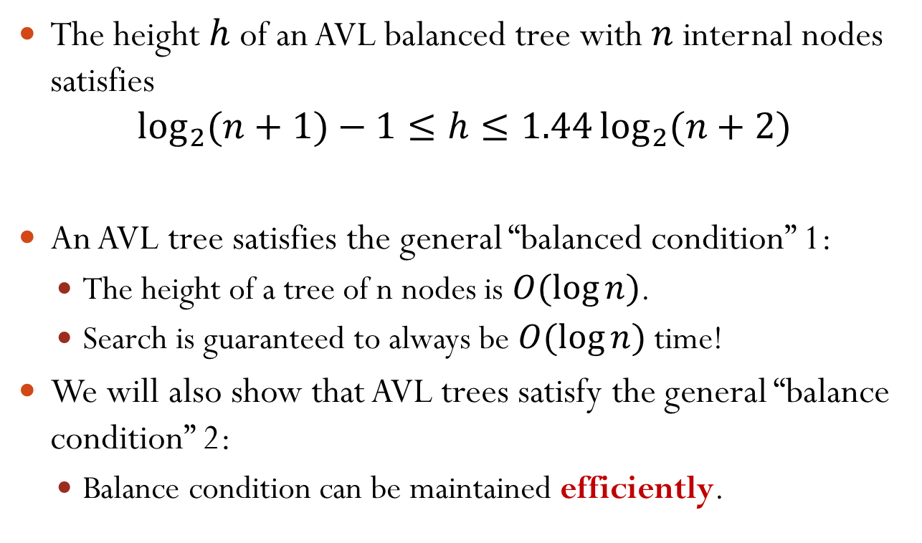
Properties of AVL Trees
The height $h$ of an AVL balanced tree with $n$ internal nodes satisfies
$$\log_{2}{(n+1)}−1≤h≤1.44\log_{2}{(n+2)}$$
An AVL tree satisfies the general “balanced condition” 1:
The height of a tree of n nodes is $O(\log{n})$.
Search is guaranteed to always be $O(\log{n})$ time!
We will also show that AVL trees satisfy the general “balance condition” 2:
Balance condition can be maintained efficiently.

Slide 9
AVL Trees Operations
Search, insertion, and removal all work exactly the same as with BST.
However, after each insertion or removal, we must check whether the tree is still AVL balanced.
If not, we need to “re-balance” the tree.

Slide 10
Re-Balance the Tree via Rotation
The rotation operation:
Interchange the role of a parent and one of its children, while still preserving the BST ordering on the keys.
Not AVL Balanced
AVL Balanced
P
A
A
P
h+2
h+1
P_{R}
h
h+1
A_{L}
h+1
A_{L}
A_{R}
h
A_{R}
P_{R}
The BST ordering on keys are preserved.
Notes:
The BST ordering on keys are preserved: A_L < A < A_R < P < P_R for both the original and the modified trees

Slide 11
Right Rotation
The right link of the left child becomes the left link of the parent.
Parent becomes right child of the old left child.
P
A
A
P
P_{R}
A_{L}
A_{L}
A_{R}
A_{R}
P_{R}
Notes:
It is basically pointer manipulation:
P->left = A->right;
A->right = P;

Slide 12
Left Rotation
The left link of the right child becomes the right link of the parent.
Parent becomes left child of the old right child.
P
A
A
P
P_{L}
A_{R}
A_{R}
A_{L}
A_{L}
P_{L}
Notes:
Similarly, we have left rotation

Slide 13
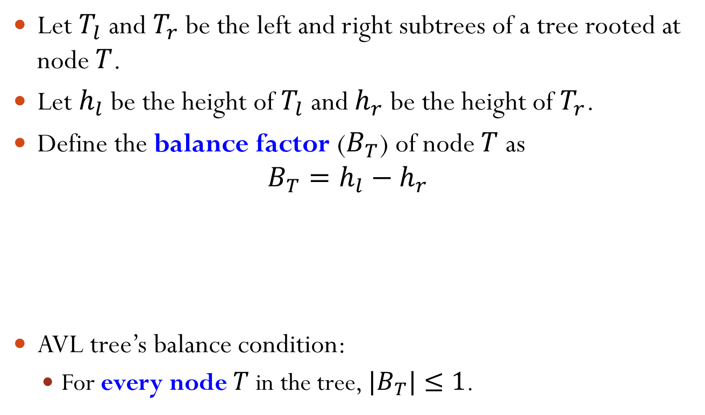
Balance Factor
Let $T_{l}$and $T_{r}$ be the left and right subtrees of a tree rooted at node $T$.
Let $h_{l}$be the height of $T_{l}$ and $h_{r}$ be the height of $T_{r}$.
Define the balance factor ($B_{T}$) of node $T$ as
$$B_{T}=h_{l}−h_{r}$$
AVL tree’s balance condition:
For every node $T$ in the tree, $|B_{T}|≤1$.
4
−1
Balance Factor Example
−1
2
6
−1
0
3
5
0
8
1
7
0

Slide 14
Outline
Balanced Search Trees
AVL Trees
AVL Tree Insertion
Supporting Data Members and Functions of AVL Tree

Slide 15
Insertion
Inserting an item in a tree affects potentially the heights of all of the nodes along the access path, i.e., the path from the root to that leaf.
When an item is inserted in a tree, the height of any node on the access path may increase by one.
To ensure the resulting tree is still AVL balanced, the heights of all the nodes along the access path must be recomputed and the AVL balance condition must be checked.
Sometimes, increasing the height by one does not violate the AVL balance condition.
In other cases, the AVL balance condition is violated.
We will fix the first unbalanced node in the access path from the leaf.

Slide 16
Breaking AVL Balance Condition Left-Left Insertion
P is the first unbalanced node in the access path from the leaf.
P
2
P
1
h+3
h+2
A
1
A
0
h+2
h+1
h
h
P_{R}
P_{R}
h+1
h
A_{L}
A_{R}
A_{L}
A_{R}
L
insert a new item
Left-left insertion: the first two edges in the insertion path from node P both go to the left.
Notes:
Note: P is the first node from the leaf that has balance factor > 1 or < -1.
(Optional) Assume the height of AL is h. The height of PR must > h-1, because we assume that before insertion the tree is AVL balanced.
The height of AL will be increased by 1. Then the height of AR must > h-1. Otherwise A’s balance factor is 2.

Slide 17
Restoring AVL Balance Condition Left-Left Rotation
P
2
How to restore AVL balance?
h+3
A
1
h+2
h
Do a right rotation at node P.
P_{R}
h+1
A_{L}
A_{R}
L
0
h+2
A
P
0
The rotation is also called left-left (LL) rotation.
h+1
A_{L}
h+1
h
A_{R}
P_{R}
L

Slide 18
Restoring AVL Balance Condition Left-Left Rotation
P
2
An LL rotation is called for when the node becomes unbalanced with a positive balance factor and the left subtree of the node also has a positive balance factor.
h+3
A
1
h+2
h
P_{R}
h+1
A_{L}
A_{R}
L
0
h+2
A
P
0
The rotation is also called left-left (LL) rotation.
h+1
A_{L}
h+1
h
A_{R}
P_{R}
L

Slide 19
Properties of Left-Left Rotation
The ordering property of BST is kept.
Both nodes A and P have balance factor of 0.
The height of the tree after the rotation is the same as the height of the tree before insertion.
A
0
h+2
P
0
h+1
A_{L}
h+1
h
A_{R}
P_{R}
L

Slide 20
Right-Right (RR) Rotation
Symmetric to left-left rotation.
An RR rotation is called for when the node becomes unbalanced with a negative balance factor and the right subtree of the node also has a negative balance factor.
−2
P
h+3
A
0
h+2
A
−1
h+1
0
P
h+2
h
A_{R}
h+1
P_{L}
h
h+1
A_{L}
A_{R}
A_{L}
P_{L}
R
R

Slide 21
Breaking AVL Balance Condition Left-Right Insertion
P
2
P
1
h+3
h+2
A
−1
A
0
h+2
h
h+1
h
P_{R}
P_{R}
h
A_{L}
A_{R}
A_{L}
A_{R}
h+1
L
insert a new item
Left-right insertion: the first edge in the insertion path goes to the left and the second edge goes to the right.

Slide 22
Restoring AVL Balance Condition Left-Right Insertion
P
2
h+3
How to restore AVL balance?
A
−1
h+2
A right rotation at node P does not work!
h
P_{R}
A_{L}
A_{R}
−2
h+1
A
L
P
1
X
h
A_{L}
A_{R}
P_{R}
h+2
h+1
L

Slide 23
Left-Right (LR) Rotation
P
2
A double rotation to re-balance:
Do a left rotation on node A; then a right rotation on node P (next slide).
A
−1
h+2
B
h
P
P_{R}
h
A_{L}
B
B_{L}
B_{R}
h
A
L
or
B_{R}
P_{R}
B_{L}
A_{L}
L
Notes:
Note: the first rotation only on node A & B

Slide 24
Left-Right (LR) Rotation
P
B
0
B
h+2
A
P
A
h+1
h+1
B_{R}
P_{R}
h
B_{L}
B_{R}
B_{L}
h
A_{L}
A_{L}
P_{R}
L
L
Notes:
The second rotation on node B & P

Slide 25
Left-Right (LR) Rotation
P
2
A
−1
h+2
B
h
P_{R}
h
A_{L}
B_{L}
B_{R}
h
An LR rotation is called for when the node becomes unbalanced with a positive balance factor but the left subtree of the node has a negative balance factor.
L
or

Slide 26
Properties of Left-Right Rotation
The ordering property of BST is kept.
Node B has a balance factor of 0.
The height of the tree after the rotation is the same as the height of the tree before insertion.
B
0
h+2
A
P
h+1
h+1
h
B_{L}
B_{R}
h
A_{L}
P_{R}
L
Notes:
BST order: A_L < A < B_L < B < B_R < P < P_R

Slide 27
Right-Left (RL) Rotation
Symmetric to left-right rotation; also a double rotation.
An RL rotation is called for when the node becomes unbalanced with a negative balance factor but the right subtree of the node has a positive balance factor.
−2
0
P
B
h+2
A
1
A
P
h+2
h+1
h+1
h
B
P_{L}
B_{R}
B_{L}
h
h
A_{R}
A_{R}
P_{L}
B_{R}
B_{L}
R
R
or
Notes:
Do a right rotation on node A; then a left rotation on node P.
BST order: P_L < P < B_L < B < B_R < A < A_R

Slide 28
Rotation Summary
When an AVL tree becomes unbalanced, there are four cases to consider depending on the direction of the first two edges on the insertion path from the unbalanced node:
Left-left
Right-right
Left-right
Right-left
LL Rotation
single rotation
RR Rotation
LR Rotation
double rotation
RL Rotation
Note: We fix the first unbalanced node in the access path from the leaf.

Slide 29
Exercises
Insert into an empty BST: 42, 35, 69, 21, 55, 83, 71.
Compute the balance factors.
Is the tree AVL balanced?
Insert 95, 18, 75?
42
−1
1
35
69
−1
0
21
55
83
1
0
71
0

Slide 30
Exercises
42
Insert 95, 18
35
69
21
55
83
18
71
95
42
21
69
18
35
55
83
71
95
Notes:
Left-left insertion at 35. Right subtree of 21 (which is empty) is connected as the left subtree of 35. Then 35 is connected as the right subtree of 21.

Slide 31
Exercises
42
Insert 75
21
69
18
35
55
83
71
95
42
75
21
71
18
35
69
83
55
75
95
Notes:
Right-left insertion at 69.
Right rotation on 83:
71
\
83
/ \
75 95
69
/ \
55 71
\
83
/ \
75 95
Left Rotation on 69:
71
/ \
69 83
/ / \
55 75 95

Slide 32
The Number of Rotations Required
When an AVL tree becomes unbalanced after an insertion, exactly one single or double rotation is required to balance the tree.
Before the insertion, the tree is balanced.
Only nodes on the access path of the insertion can be unbalanced. All other nodes are balanced.
We rotate at the first unbalanced node from the leaf.
By the properties of rotation, the height of the node after rotation is the same as that before insertion.
All ancestors of that node on the access path should now be balanced.

Slide 33
Outline
Balanced Search Trees
AVL Trees
AVL Tree Insertion
Supporting Data Members and Functions of AVL Tree

Slide 34
AVL Trees Supporting Data Members and Functions
int Height(node *n) {
if(!n) return -1;
return n->height;
}
struct node { Item item; int height; node *left; node *right; };
void AdjustHeight(node *n) { if(!n) return;
n->height = max( Height(n->left),
Height(n->right) ) + 1;
}
int BalFactor(node *n) {
if(!n) return 0;
return (Height(n->left) –
Height(n->right));
}
Notes:
Height function is the first function.

Slide 35
AVL Trees Supporting Functions
void LLRotation(node *&n);
void RRRotation(node *&n);
void LRRotation(node *&n);
void RLRotation(node *&n);
void Balance(node *&n) {
if(BalFactor(n) > 1) {
if(BalFactor(n->left) > 0) LLRotation(n);
else LRRotation(n);
}
else if(BalFactor(n) < -1) {
if(BalFactor(n->right) < 0) RRRotation(n);
else RLRotation(n);
}
}
Notes:
Note: argument is a reference to a pointer. For the first “else”, the BalFactor cannot be 0. Therefore, BalFactor must < 0 and it satisfies the LR insertion condition.

Slide 36
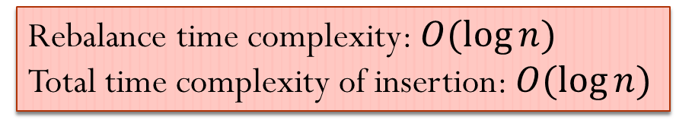
AVL Trees Changes to Insertion
void insert(node *&root, Item item) { if(root == NULL) { root = new node(item); return; } if(item.key < root->item.key) insert(root->left, item); else if(item.key > root->item.key) insert(root->right, item);
Balance(root);
AdjustHeight(root); }
Rebalance time complexity: $O(\log{n})$
Total time complexity of insertion: $O(\log{n})$
Notes:
Overall behavior: Balance and AdjustHeight start from the leaf node on the access path towards the root node. Once the unbalance condition is fixed at a node, its ancestors do not need to be fixed anymore.

Slide 37
Removal
First remove node as with BST
Then update the balance factors of those ancestors in the access path and rebalance as needed.

